Slide 1
An application of 24ghz radar for contactless heartrate monitoring
Presented by: Oisin Watkins

Slide 2
Contents
Project Outline
Ideal End-goal… and the steps from here to there
Signal basics: Understanding the problem and the Platform
Begin designing
Test the design – Understanding Success
The data
Conclusions

Slide 3
Project outline
Title was defined while working on co-op in Analog… Before you go asking for an FYP from ADI, there’s some things you should know…
With ADI joining the self-driving car race, new ways of monitoring passengers while in the vehicle are being experimented with.
Audi have an on-board Emergency contact system in the event of an accident, however it is bare boned. This project is among the first attempts to flesh the idea out further.

Slide 4
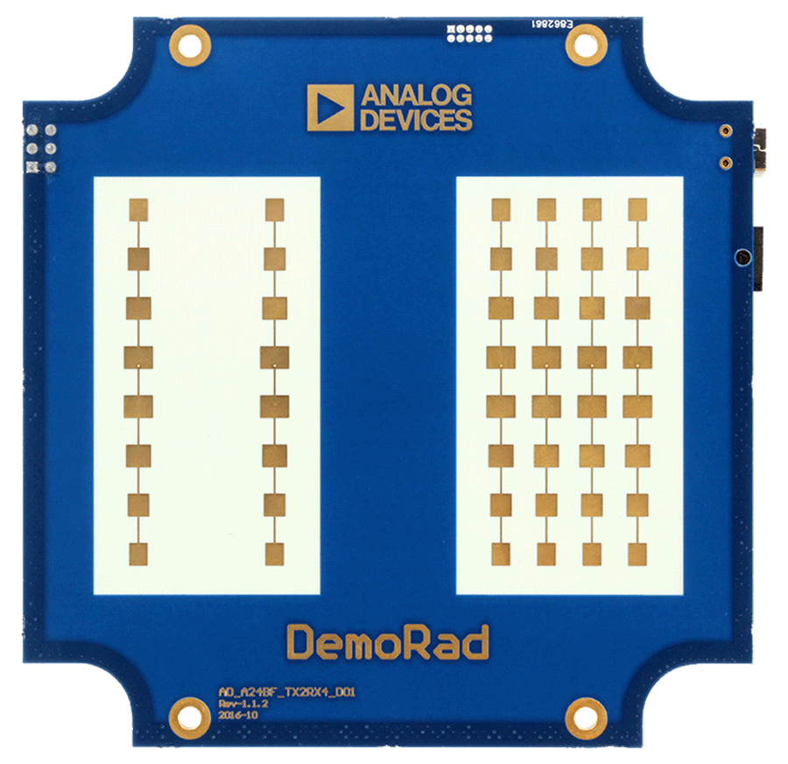
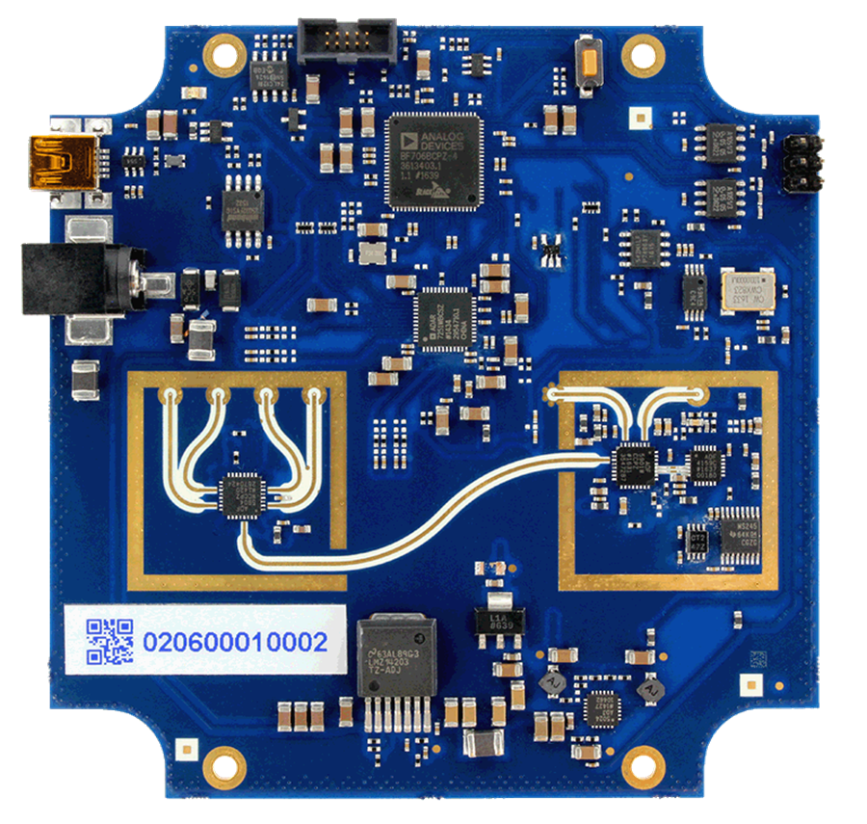
Project outline ctnd.

Slide 5
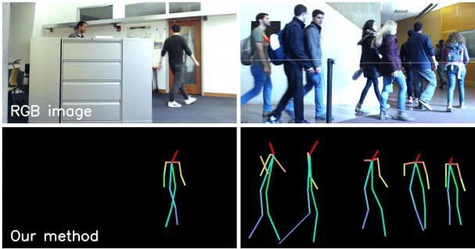
Ideal end goal…and steps from here to there
Previous work done with the Demorad has proven that it is possible to track the movement of multiple objects in the field of view of this device.
The end goal of this project is to design an application which can measure the heart-rate of a subject which is compatible with this previous work.

Slide 6
Ctnd.
Now how to get there?
The first step is knowing how the project was done previously
Research the measurement -> Know what you’re looking for
Next, review other methods of taking the measurement (This will be important later)
Begin designing your method (This will be an iterative stage)
There is no point in designing a tool to take a measurement when you know nothing about that measurement! Do the reading first, then see what other people have done with the same information you have.
The testing part has been left out deliberately here, I’ll come back to that…

Slide 7
Signal basics: Understanding the problem and the Platform
Most of you are about to hate me…..

Slide 8
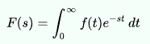
REMEMBER ME??!!

Slide 9
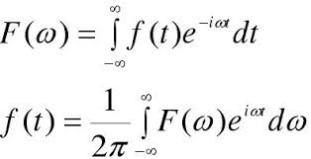
Yup, it’s back… Sadly there’s no real escaping it…
But you don’t need Laplace specifically, you need one of his more specific adaptations
Most of you should be familiar with the Fourier Series, below is the Fourier transform. Basically it’s the Laplace transform where s = jw.
Why is this useful…?

Slide 10
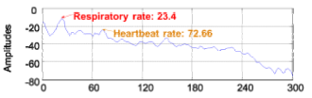
This is why!
Given any signal in the time domain, its frequency content can be extracted using Fourier analysis.
Take for example this project. No matter what form the measurement takes, the entire objective is to discern at what frequency the heart is pumping at.
Next, we know that the Demorad can only measure distance from itself to a target, regardless of the setup used.
Now the measurement type becomes a lot more clear. Previous researchers working in the same field (though using a different type of RADAR) found the following information about chest-wall movement:
per Minute

Slide 11
So what can the Demorad do?
The Demorad is inherently a Multiple Input Multiple Output (MIMO) device, which has some useful properties:
Provides a very wide field-of-view (which was exploited for the tracking people project)
Also readily supports Digital Beam Forming, high resolution measurement which ports excellently to tracking multiple targets.
It does however lead to some costly computations, which can (and in this case does) slow down computation time. BIG PROBLEM
But enough is now known that a prototype design can be built.

Slide 12
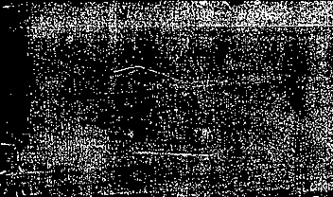
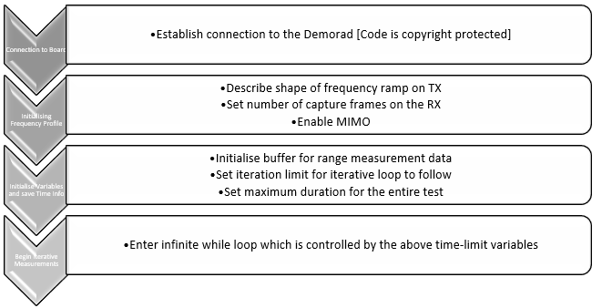

Begin designing
This is largely an iterative process, but I’m not really allowed to tell you everything ☹
I can, however, show you these:
This is a very high level overview of the design. These first steps only connect the board to the host PC and establish some variables I will need later on.

Slide 13
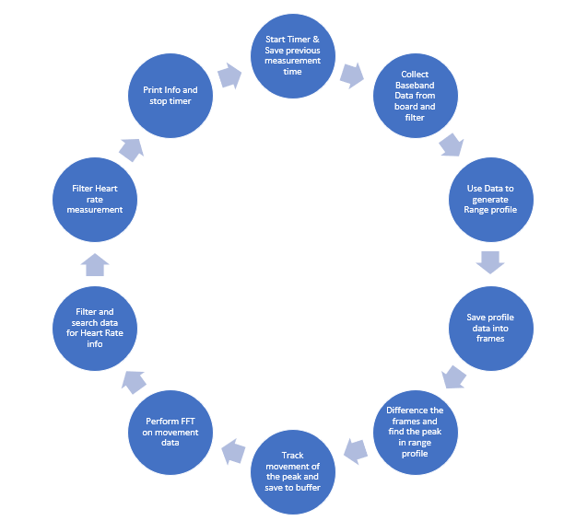
Here is where the measurement happens. One run of this loop corresponds to one heart rate measurement.
Depending on the filter applied to the heart rate very different result will be achieved. The accuracy of the design largely varies with the run time of this loop on the left.

Slide 14
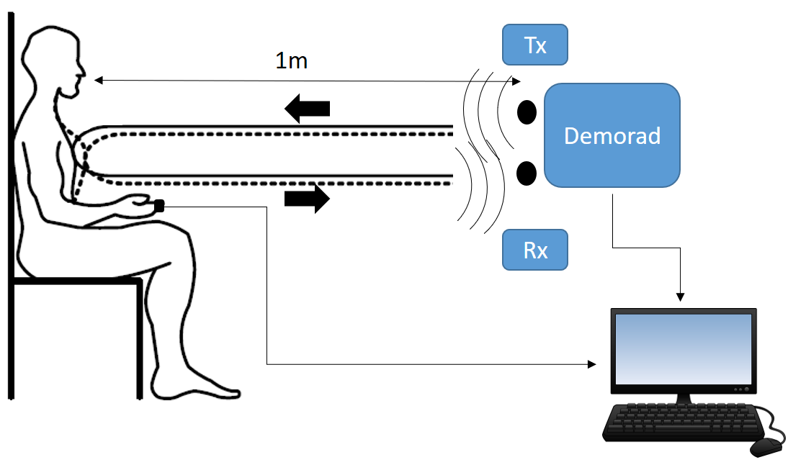
Test the design – understanding success
By now most of you will probably have come up with a fairly simple test layout:

Slide 15
If you did, you’re spot on the money. This follows the layout of what’s called a Method Comparison Study.
These studies generally provide characterisation data, typically represented in a scatter plot. This provides information regarding the relative accuracy of the test method with the gold-standard method
However in running the experiment time-series data is gathered. These provide very different types of data, and although it’s no less useful, it is a different type of analysis.
So what’s to be done?

Slide 16
This is why I highlight UNDERSTANDING SUCCESS
Part of the project outline specified with ADI listed that the resulting prototype must have an accuracy of 90% or higher. Characterisation data probably would have provided such information, however when I display the results you’ll see that all data clusters around the 75-85 bpm mark.
So now we’re confined to using time-series analysis. There are more readily-available measures of accuracy with this type of analysis, but you have to be careful…

Slide 17
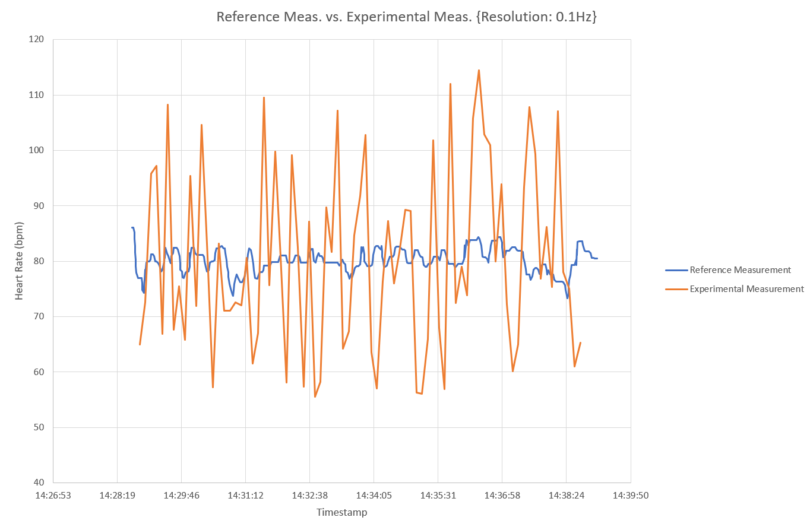
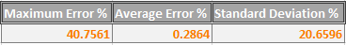
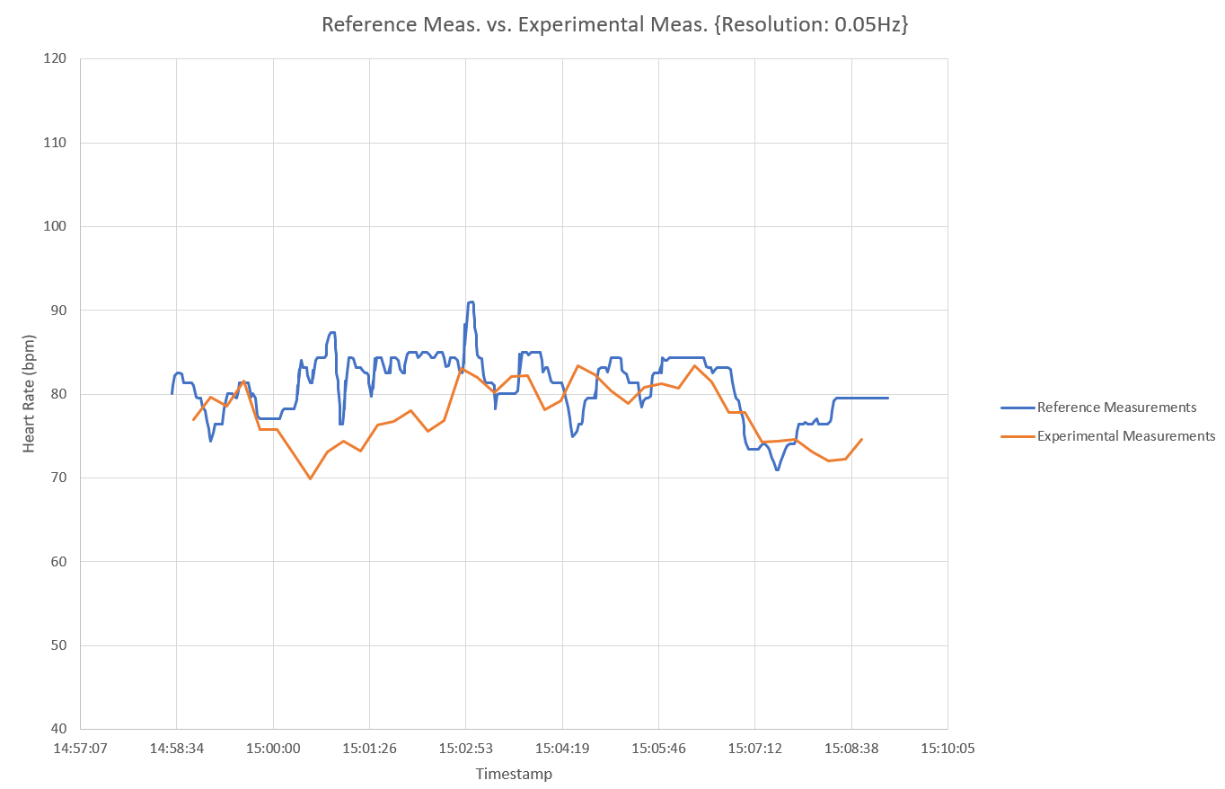
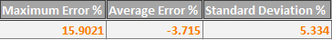
The data
See the problem?
Here each design is evaluated using Maximum error, Mean percentage error (average error) and standard deviation of the error.
No measurement on its own means anything, so none of these definitions of error are appropriate.

Slide 18
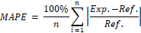
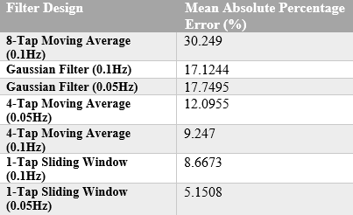
Luckily there are other metrics, such as Mean Absolute Percentage Error:
Accounts size of error without being biased when given zero-centered error.
Can have problems when the reference measurement falls to zero, however my test subject was never dead so that wasn’t an issue.

Slide 19
Conclusions
Accuracy of 94.85% reached! ☺
Test was only carried out on one subject, due to time constraints. Gathering enough data to perform Method Comparison analysis would be the ideal next step.
There are also other ideas I’d like to give a try to, but those can wait for the time being.
Thank you all for listening!

Slide 20


